Slide 1
CSC 2430 Lab 6
CSC 2430 Dr. Benson & Dr. Arias
WINTER 2020 OMH 232 & OMH 209
MWF 11:00am – 12:20 pm BENSONM@spu.edu
OMH 225 & OMH 245 ARIAS@SPU.EDU

Slide 2
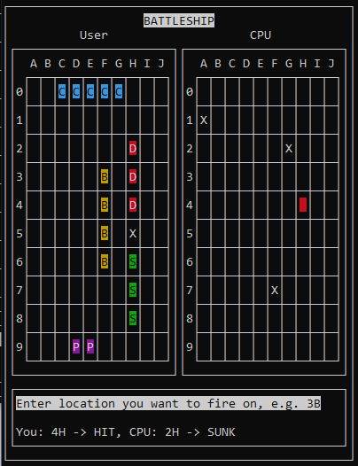
Lab 6 – how is the game going to work?
Design for main() function:
1) Get seed for random number generator
2) Get the ship configuration for the user
3) Get the ship configuration for the CPU
4) Show the initial display
5) Enter game loop
Prompt the user for a location to fire on
Fire at that location and update the display
If the user didn’t win the game
Get the CPU’s location to fire on
Fire at that location and update the display
Write out the results of the user and CPU’s shots
If user or CPU wins game, break out of loop
6) GUI stays up until user enters a character

Slide 3
Lab 6 – top level classes
The main program will only make calls into two classes
GameBoard – responsible for all graphical display and grid logic
CpuLogic – this is the class you wrote
The above two classes do not “talk to each other” to keep the CPU from “cheating” and looking at the user’s grid

Slide 4
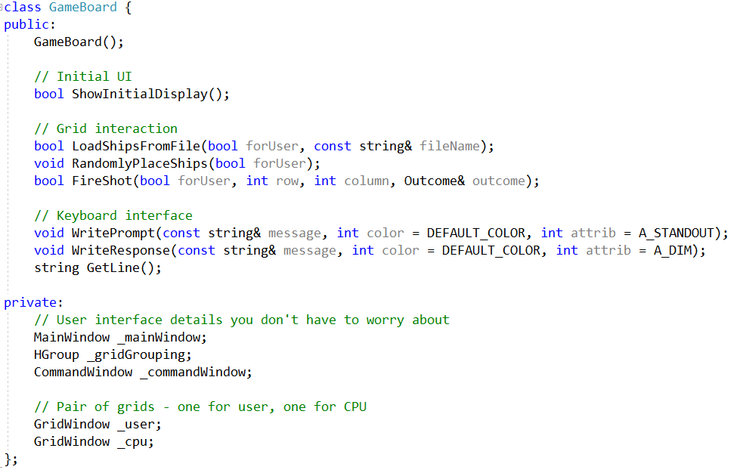
Lab 6 – GameBoard class
The only methods of this interface you need to implement are
1) LoadShipsFromFile
2) RandomlyPlaceShips 3) FireShot
Your main job with these three methods will be to “plumb” the calls through to either _user or _cpu depending on the value of the forUser parameter
Note that the main program will use all the public methods of the GameBoard class, but the rest have been implemented for you

Slide 5
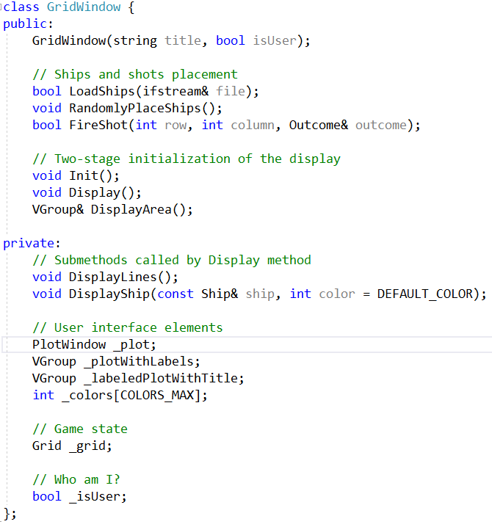
Lab 6 – GridWindow class
This class is responsible for all grid functionality including display
The private members you will use:
1) _plot – this object is what you will use to produce a visual display the ships on the grid
2) _grid – this object is an instance of the Grid class you wrote in Lab 5
3) _isUser – this is true if this object is the user’s grid, and false if it is not

Slide 6
Lab 6 – GridWindow class
You will need to implement the following methods
1) Display – produces initial display of ships
2) FireShot – this calls _grid to fire a shot and then depending on the outcome updates the display
3) LoadShips – calls same named method on _grid object
4) RandomlyPlaceShips – calls same named method on _grid specifying the standard list of ships used for the Battleship game
5) DisplayShip – used by both Display and FireShot to display a ship on the grid, this uses the _plot object to write to the screen

Slide 7
Lab 6 – Plotting
When you implement GridWindow::Display, GridWindow::FireShot and GridWindow::DisplayShip, you will need to use the _plot member object
In some cases you will need to write characters to the display at specific locations and with specific colors using this method of the PlotWindow class:
For all three GridWindow methods, your last statement should be to call this method:
If you don’t call this function, your writes will probably not display on the screen

Slide 8
Lab 6 – Plotting
Some tips on using this method to write a character at position x, y with a specified color and character attribute
1) The gridlines are made up of characters. Take that into account when determine what x and y should be:
For “C” in square 0C, x = 5, y = 1
For “D” in square 2H, x = 15, y =5
2) You can omit the attrib attribute and let it default to A_NORMAL
3) How do you determine what color value to use?
For squares of ships on the user’s grid that aren’t sunk
In Display and FireShot, use the ship’s index to select a color from the _colors member array
In DisplayShip the color is passed in
For squares of ships that are hit, use RED_INVERSE
If you are just plotting an “X”, you can omit the color parameter and let it default

Slide 9
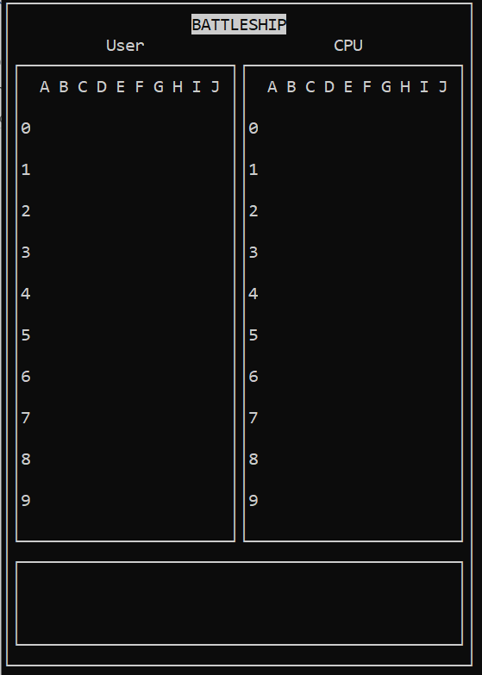
Lab 6 – Implementation Steps
1) Implement the three GameBoard methods by calling into methods of the correct GridWindow object.
2) Implement the two GridWindows methods related to ship configuration
3) Implement the initial portion of the main program – after this the program should build and you will see graphics

Slide 10
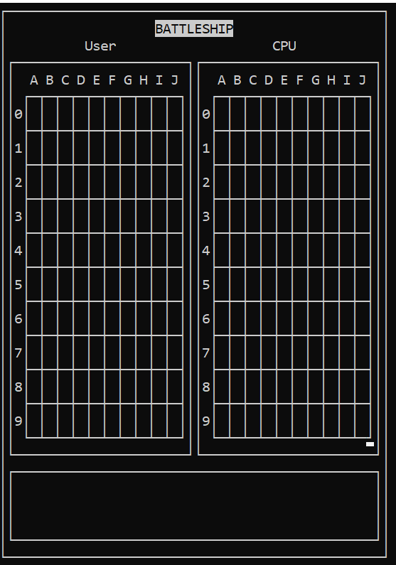
Lab 6 – Implementation Steps
4) Add code to the GridWindows::Display method to display the grid lines

Slide 11
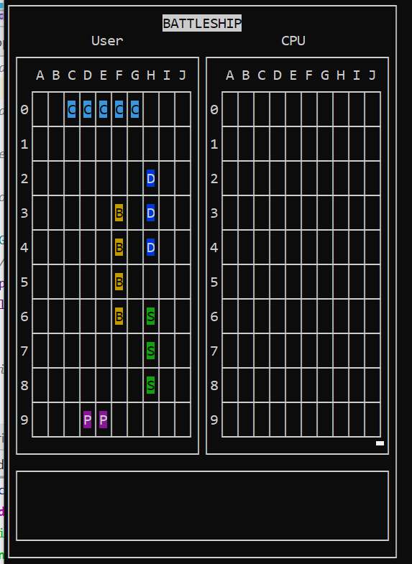
Lab 6 – Implementation Steps
5) Implement GridWindows::DisplayShip and add additional code to GridWindows:: Display to call DisplayShip for each ship on the grid

Slide 12
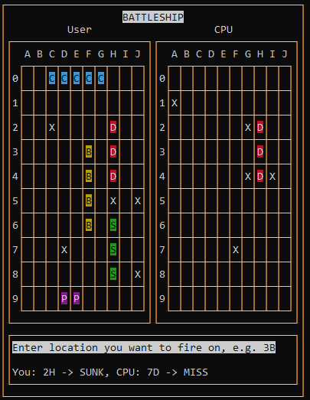
Lab 6 – Implementation Steps
6) Implement GridWindows::FireShot
7) Add the game loop

Slide 13
Lab 6 – Platform
You will continue to use CLion to write your code and build your program, but you need to run your program on WSL or Docker
Make sure you are using correct CLion Toolchain

Slide 14
Lab 6 – Extra credit opportunity
A better CpuLogic class will
Try nearby squares after a square of a ship is hit until ship is sunk, and then return to picking random squares
Any extra credit will probably be awarded later in the quarter, but you should finish it now

Slide 15
Lab 6 Grading Rubric
Score = Runtime Testing + Code Expectations – Programming Defects
Runtime Testing:
Maximum of 95 points will be awarded if your code passes all our tests.
Code Expectations:
Maximum of 5 points awarded if your code meets expectations in 2 different categories
Programming Defects:
Points deducted for various types defects in your code
Total number of points: 100

Slide 16
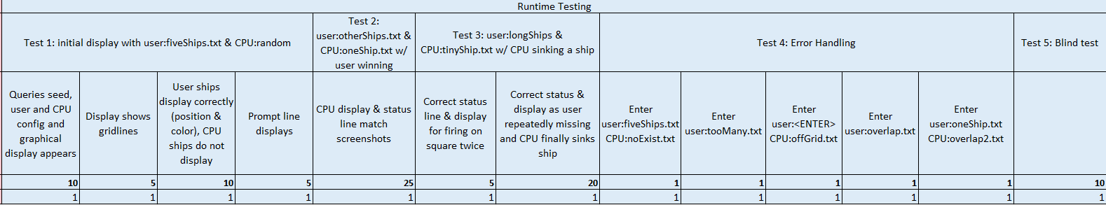
Lab 6 Grading Rubric
Score = Runtime Testing + Code Expectations – Programming Defects
Runtime Testing: Maximum possible points 95
Note: Test 3 uses 10 square long ships, and Test 4 which may exercise your AddShip more than you may have done before. Make sure these files work with your grid object NOW Don’t wait until the last day.

Slide 17

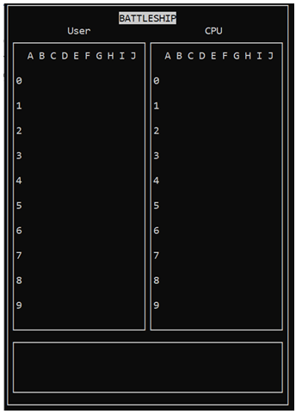
Lab 6 Grading Rubric
Runtime Testing: Test 1 – first part
+10 points – successful enter of initial information and some graphic display appears
Hopefully you will have a full display of the ships, this is the minimum

Slide 18
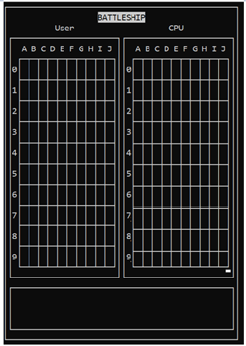
Lab 6 Grading Rubric
Runtime Testing: Test 1 – second part
+5 points – the gridlines also display

Slide 19
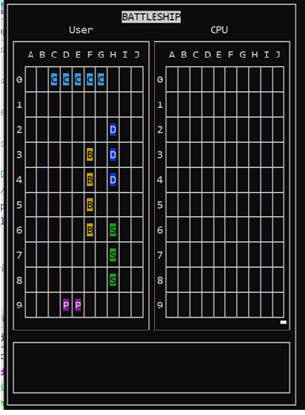
Lab 6 Grading Rubric
Runtime Testing: Test 1 – third part
+10 points – the ships display in correct color and positions

Slide 20
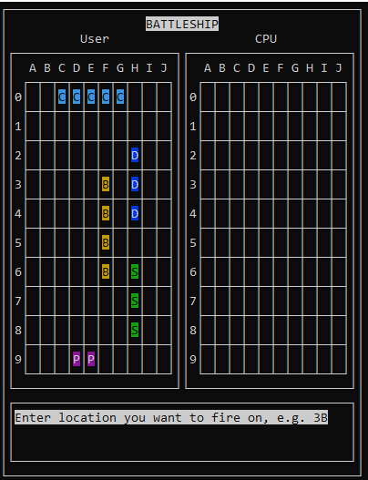
Lab 6 Grading Rubric
Runtime Testing: Test 1 – fourth part
+5 points – prompt line displays
Total points for Test 1: 30 points

Slide 21

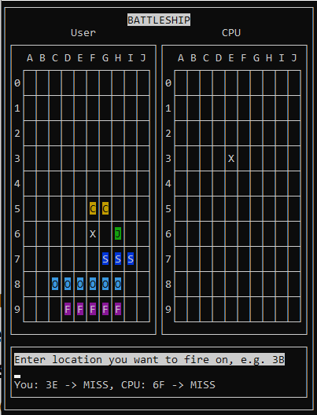
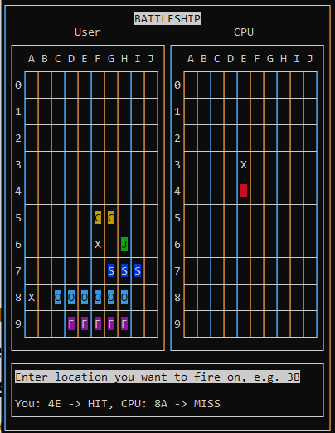
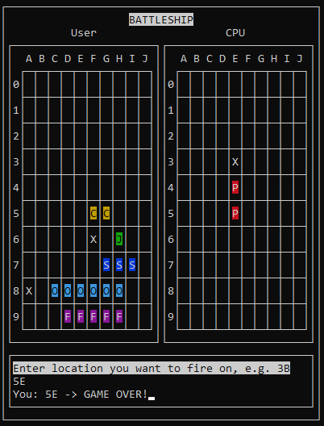
Lab 6 Grading Rubric
Runtime Testing: Test 2
30 points – you fire at 3E, 4E, 5E and win, CPU grid display and status printed has to match screenshots, user display and status may differ from screenshot since CPU may shoot in different locations, but should be correct . Hit ENTER after game won ends program

Slide 22

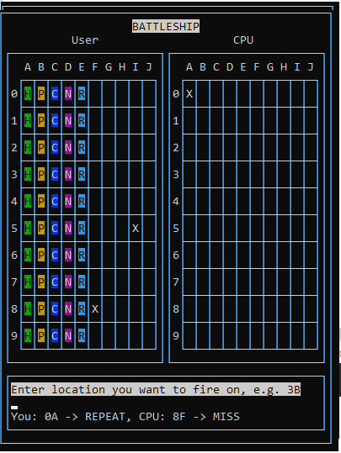
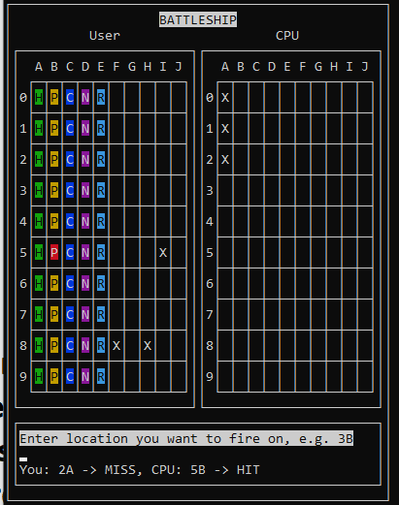
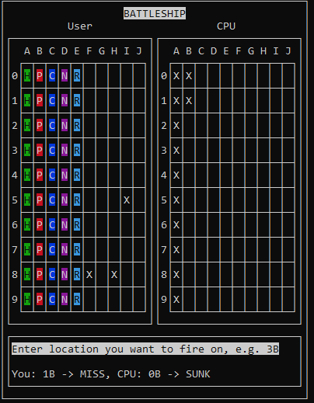
Lab 6 Grading Rubric
Runtime Testing: Test 3
30 points – you fire at 0A twice to verify the status message in the screen shot, then continue firing 1A, 2A, 3A, … 9A, 0B, 1B, … until the CPU sinks a ship of yours

Slide 23





Lab 6 Grading Rubric
Runtime Testing: Test 4 – Error Handling

Slide 24
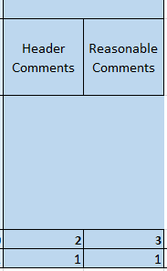
Lab 6 Grading Rubric
Score = Runtime Testing + Code Expectations – Programming Defects
Code Expectations: Maximum possible points 5

Slide 25
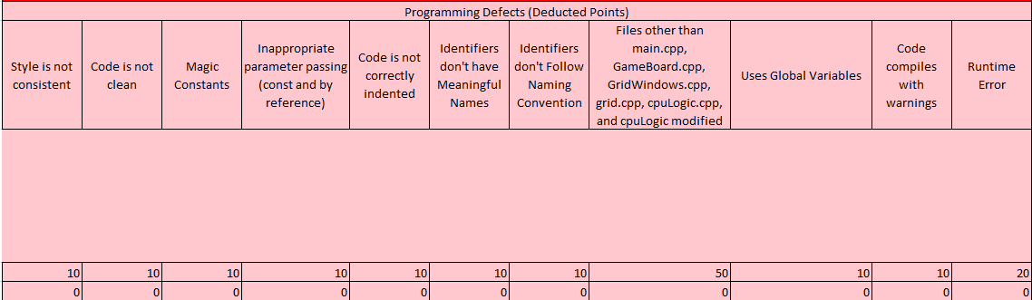
Lab 6 Grading Rubric
Score = Runtime Testing + Code Expectations – Programming Defects
Programming Defects: areas where points may be deducted
Same as in Lab 5
Make sure you Build rather than Run, and check for warnings

Slide 26
Lab 6
Due: Wednesday, Feb 26 @ midnight
Start now
Ask questions:
Me: Office Hours in OMH 232 MW 12:30-2pm, F 9:30-10:30am
Dr. Arias: schedule via https://calendly.com/c-arias/appointment​
Tutor: schedule via https://www.signupgenius.com/go/5080e4caba82aa3f85-python

